Slide 1
Soar Technology Company Update 2017

Slide 2
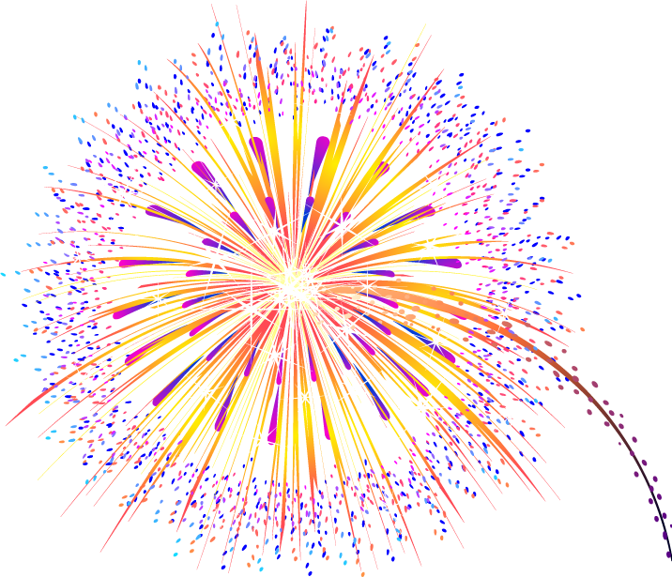
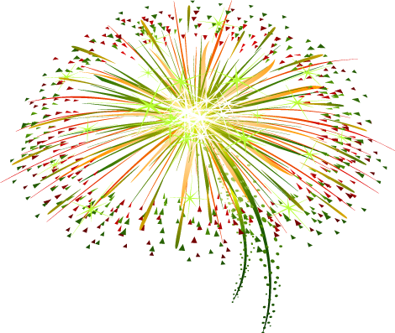
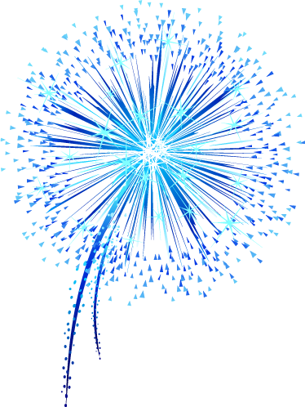
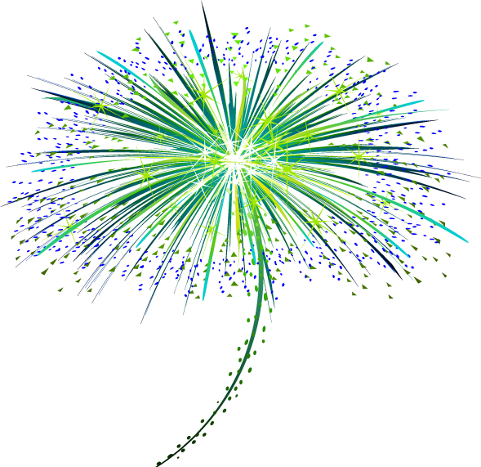
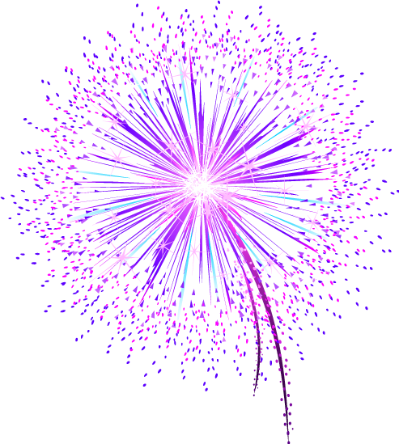
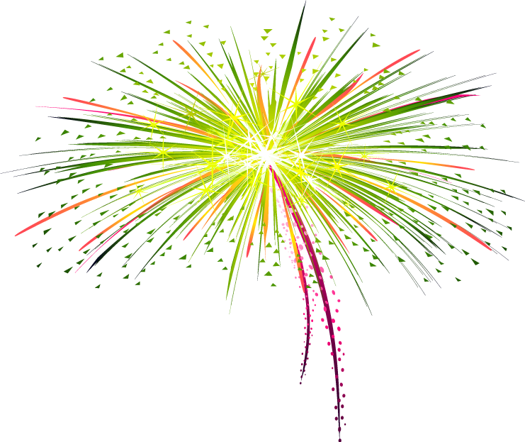
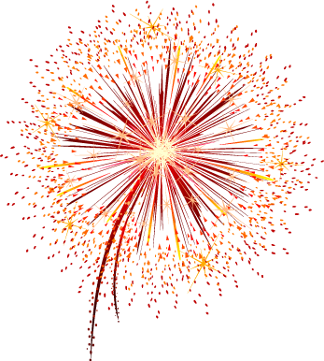
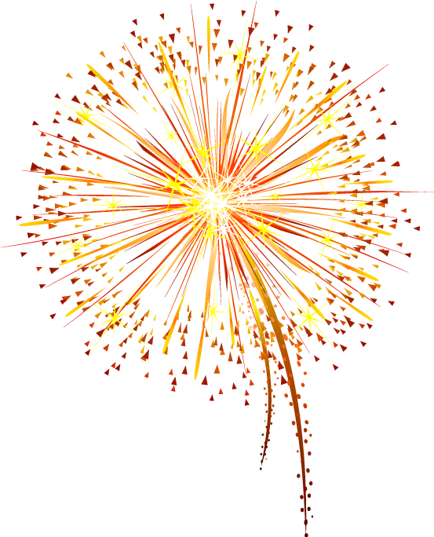

SoarTech’s 20th Anniversary

Slide 3
SoarTech: The Early Days
Date of Incorporation: May 19, 1997
First contracts in early 1998
Founders
John Laird
Randy Jones
Paul Nielsen
Frank Koss
Karen Coulter
Early employees still with SoarTech
Glenn Taylor: November, 1998
Rich Frederiksen: August, 2000
Jacob Crossman: September, 2000
Bob Wray: January, 2001
Jack Zaientz: August, 2001
Laura Hamel: October, 2002
Brian Stensrud: September, 2003

Slide 4
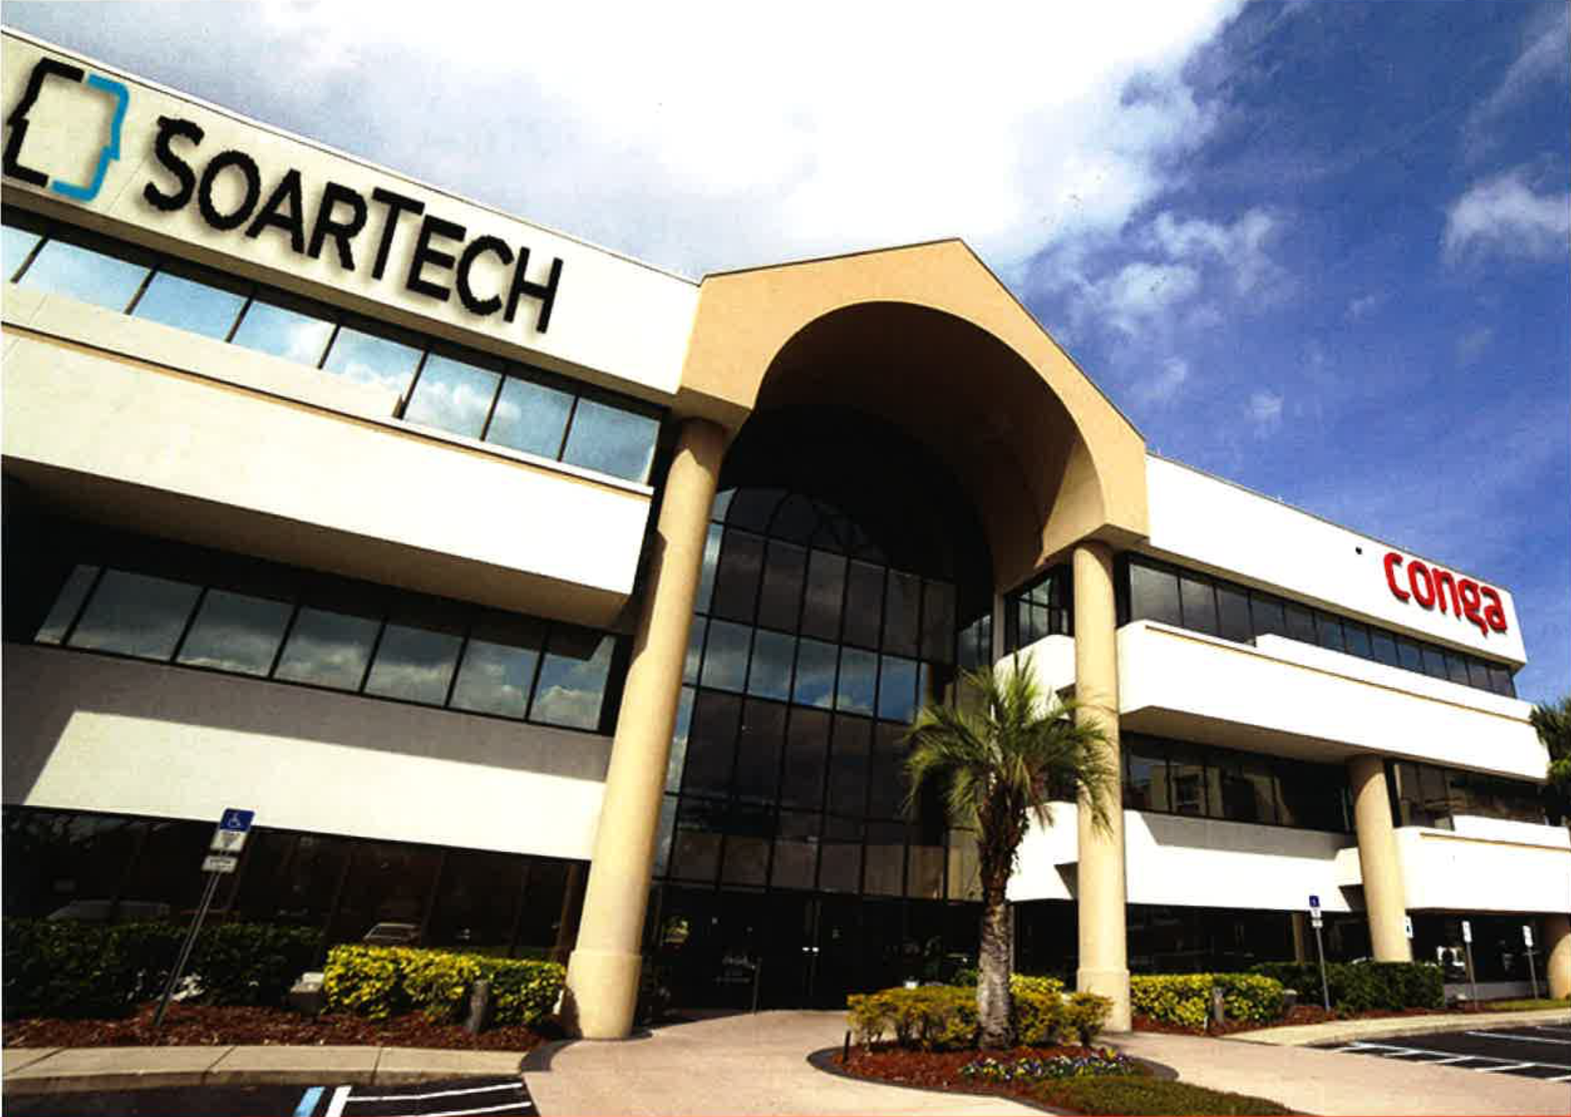
SoarTech: Today
84 Employees
15 hired so far in 2017 (plus 8 interns)
9 accepted offers scheduled to join (plus 1 more intern and 2 West Point Cadets)
16 open positions we’re looking to fill yet this year (hint, hint)
80% Technical Staff, 20% Support Staff
Annual revenue: $15,000,000
About 65 active research contracts at any given time
Primary funding sources: ONR, DARPA, ARL, AFRL
Approximately 40% of our projects use Soar
Other tools in our AI toolbox: Various deep learning approaches, Swarming approaches, Computer vision, Finite state machines
Two main offices and employees working in 9 states
Ann Arbor, MI: ~51 employees
Orlando, FL: ~26 employees
Employees also working in California, Maine, Maryland, North Carolina, Ohio, Vermont, Virginia, Alabama soon
Soar Automotive: First commercially focused spin off

Slide 5



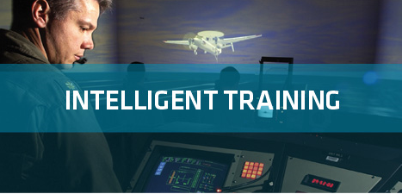
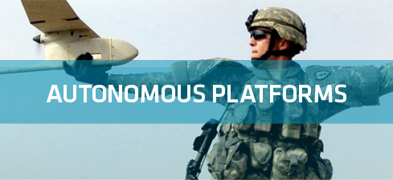
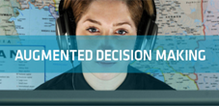
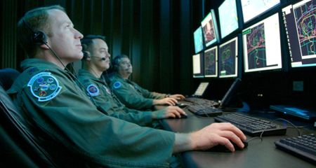
Soar Technology, Inc.
Spinoff of University of Michigan AI Lab (Soar Group)
R&D in Wide Array of Cognitive and Social Architecture Technologies
Market Segments
CyberSPACE OPERATIONS
Full spectrum behavior models
Individually varied training & assessment
Serious Games
Human-Robot Interfaces
Situational Awareness
Cognitive Control for Autonomous Platforms
Autonomous Cyberspace Capabilities
Cyberspace Workforce Development
Cyberspace C2 & Analytics
Focus Areas
LVC (ONR)
UASSIST (ONR)
FLUENT (ADL)
RedSpinUp (AFRL)
TigerBoard (Army)
ADSUDM (ONR)
VESIP (Dept. of Ed)
SquadMate (DARPA)
CODE (DARPA)
Daisy (DoT)
TALOS (SOCOM)
SAPIENT (CERDEC)
SID (multiple)
MAGIC (IRAD), …
SC2RAM (ONR)
CYSTINE (AFRL)
ROS-M (Army)
COLD KNIFE (SPAWAR)
Applied Research & Experimentation Partner (ARL Cyber CTA)
Technology
Applications

Slide 6
Contributions to the Soar community
jSoar
See 2015 talk
New features in cSoar
See 2014 talk
NGS
See 2017 talks
SoarIDE
See 2016 talk
Soar Programmer’s Guide
See 2015 talk

Slide 7
Nuggets and Coal
Nuggets
A great place to do interesting work
Advancing and applying artificial intelligence
Smart, fun new co-workers as a result of the company’s growth
A model for commercial spin offs is coming into focus
Coal
The phrase “very good problems to have” still includes the word “problems”

